Slide 1
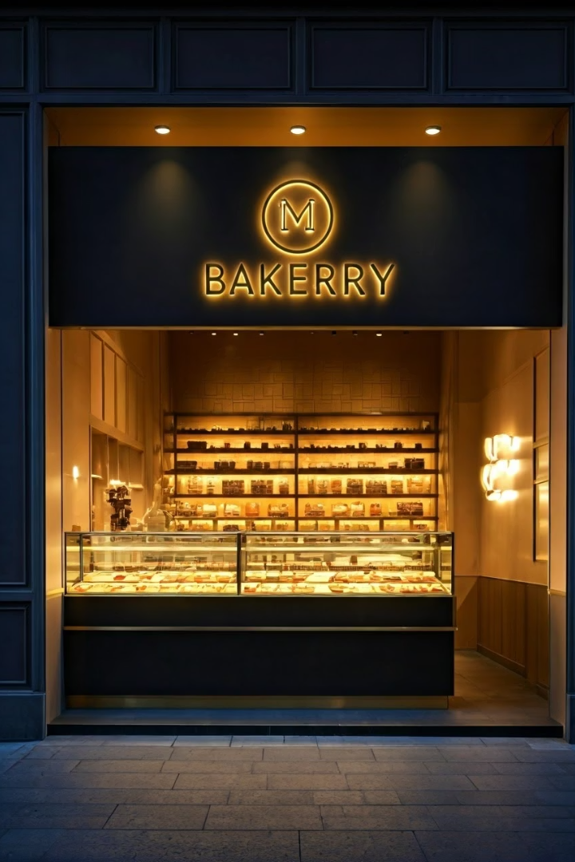
Bakery Management System
Automating bakery operations with C programming offers a streamlined approach. This system manages everything from order placement to inventory. It provides a comprehensive overview of bakery operations, ensuring efficiency and accuracy.
NAME:RAJ SHARMA
UID:24BCA10553

Slide 2
System Architecture
Modular Design
Data Handling
The system uses modular design for key components and interactions. This design includes order management and inventory tracking.
Centralized data handling ensures efficiency. Sales reporting is also integrated into the module, streamlining data flow.

Slide 3




Data Structures and Algorithms
Data Structs
Structs are used for orders, products, and ingredients. This structure organizes data effectively.
Linked Lists
Linked lists enable dynamic inventory management, adjusting to real-time changes.
Algorithms
Efficient algorithms optimize search and sorting, enhancing system performance.

Slide 4
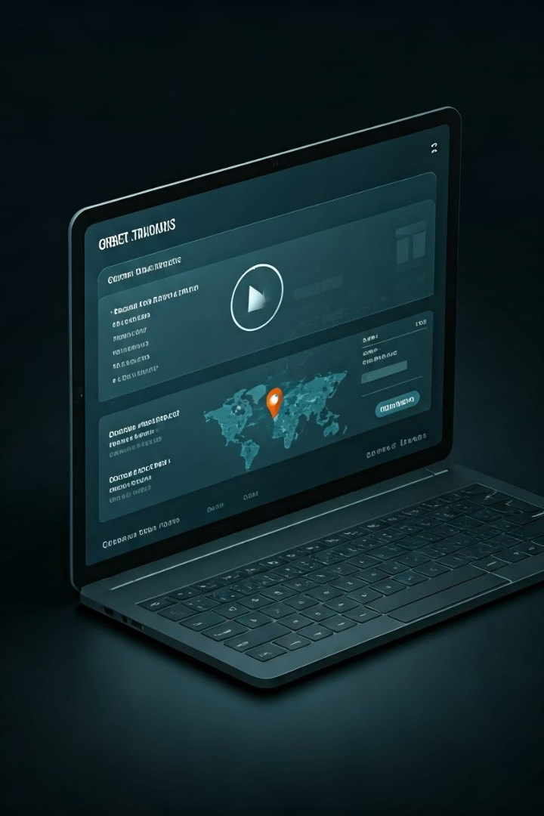
Order Management Module
Real-time Entry
Customer Information
Facilitates real-time order entry and tracking. Quick updates ensure smooth operations.
Captures customer information and order details accurately. Enhances customer satisfaction.
Delivery Status
Provides tracking of delivery status. Improves communication with customers.

Slide 5






Inventory Control Module
Stock Level Alerts
Monitors stock levels and sends alerts for timely reordering. Prevents shortages.
Automated Tracking
Tracks ingredients and products automatically, reducing manual effort.
Supplier Integration
Integrates with supplier management, streamlining the supply chain.

Slide 6
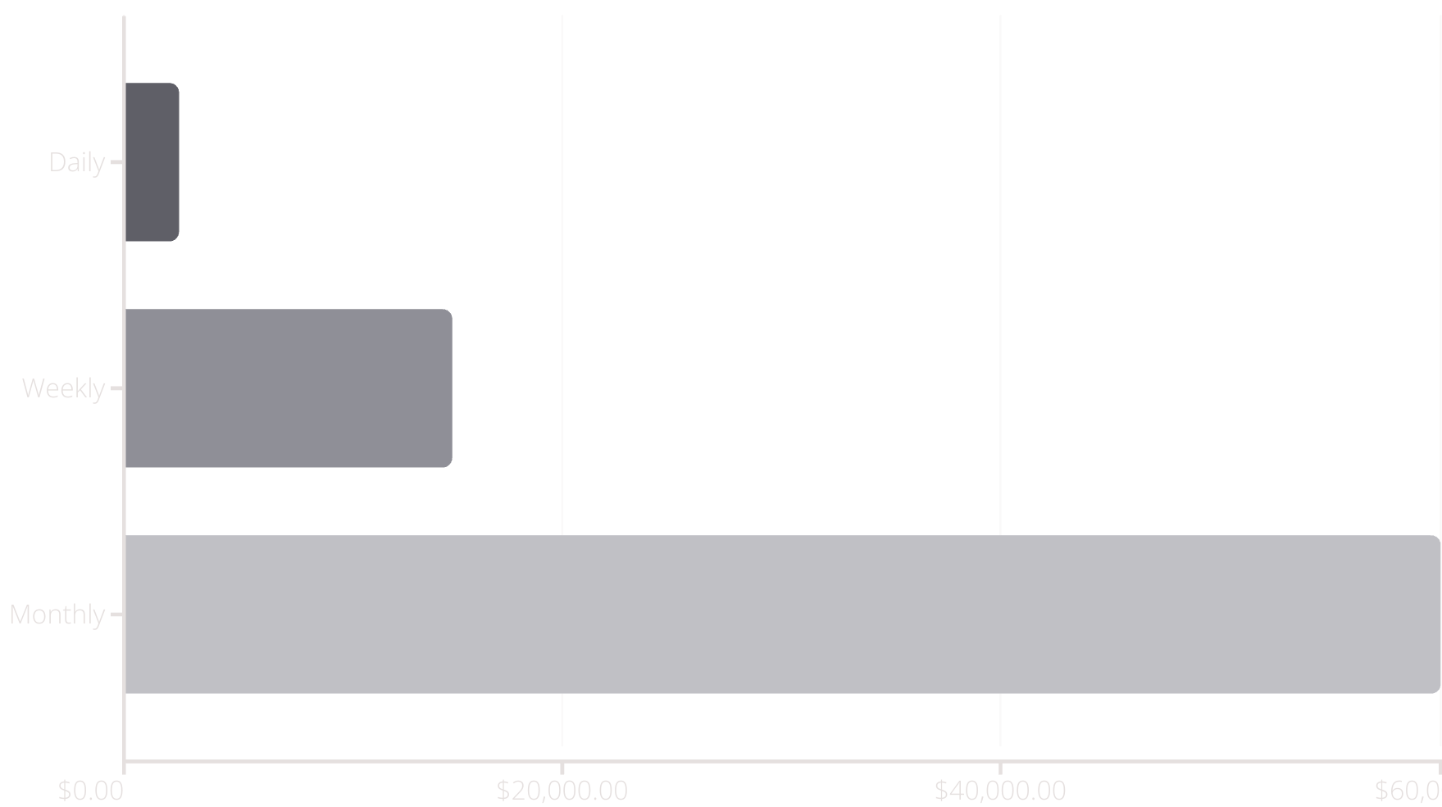
Sales and Reporting Module

Slide 7




Implementation and Challenges
C Language Specifics
Data Validation
Testing Strategies
Memory management and pointers require careful attention.
Effective data validation and error handling are essential. This prevents system crashes.
Rigorous testing and debugging are crucial for stability.

Slide 8
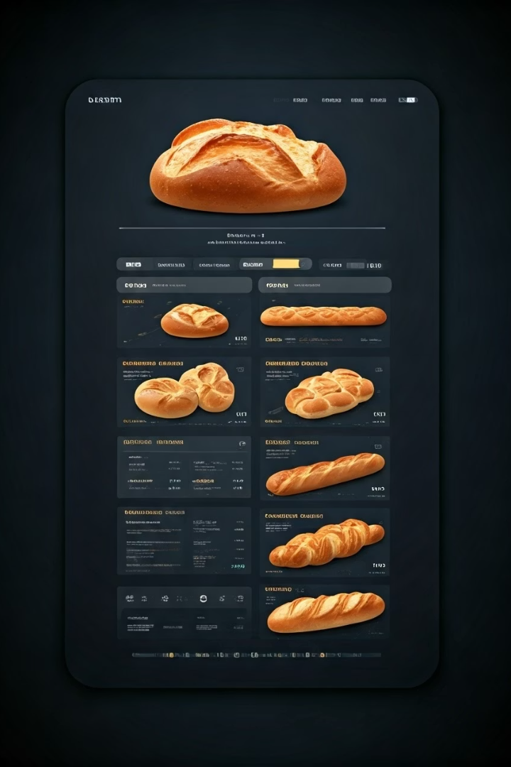
Conclusion and Future Enhancements
Benefits of C
C-based system offers scalability, customization, and high performance.
Future Enhancements
Potential improvements include UI/UX upgrades and cloud integration.
A C-based baker management system delivers efficiency and adaptability. Future enhancements promise an even more powerful solution.

